Slide 1
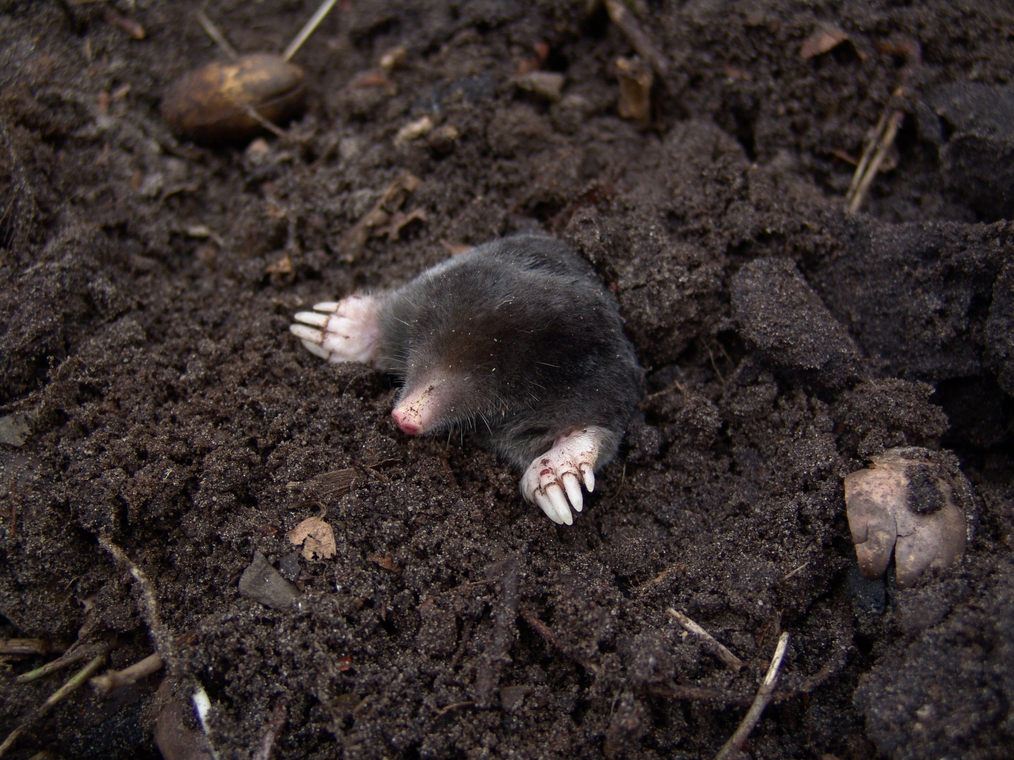

CIPRA Groundbreaking
Soil life and restoration

Slide 2
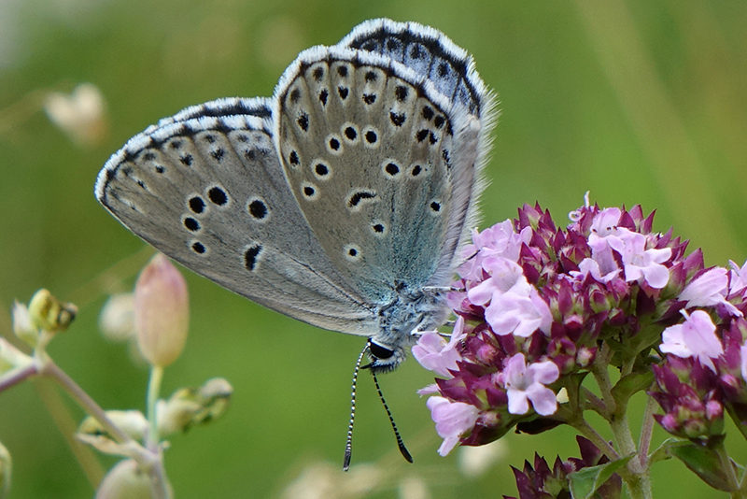
Diversity of soil organisms
“Essentially, all life depends on the soil ... There can be no life without soil and no soil without life; they have evolved together.”
— Charles E. Kellogg, USDA Yearbook of Agriculture, 1938
Phengaris arion (pic: Jutta Bastian/URL 1)
www.lepiforum.de (viewed: 11.5.2024)
Notes:
• Soil is one of the most diverse habitats on Earth. It is estimated that up to ¾ of species worldwide are found in soils. So, nowhere in nature are species so densely packed as in soil communities. - all the colorful world – like this thyme plant and dark spottet large blue- above ground would not exist!

Slide 3
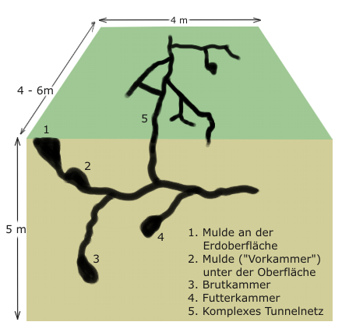
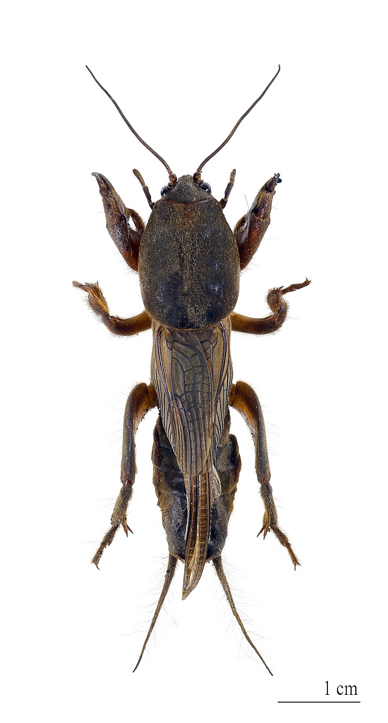
Life under extreme conditions
Eternal darkness
Labyrinth of sand, silt or clay
Tiny tunnels and pores, with air around, that is almost completely water-saturated
100% humidity, no wind
Carbon dioxide accumulates
oxygen levels are low
communication usually via chemical ways
usually silent but some of the crawly creatures get really loud: sound of soillife.mp3
Von Didier Descouens - Eigenes Werk, CC BY-SA 4.0, https://commons.wikimedia.org/w/index.php?curid=15621904
Von Roger Zenner - Eigenes Werk (Originaltext: Gezeichnet von: Roger Zenner), CC BY-SA 2.0 de, https://commons.wikimedia.org/w/index.php?curid=24018294
Notes:
Most of the archaea known to date are extremophiles, i.e. adapted to the extreme conditions of their biotopes. Many representatives have the ability to live at very high temperatures (hyperthermophiles above 80 °C), very low or very high pH values (acidophiles or alkaliphiles), high salt concentrations (halophiles) or high pressures (barophiles).

Slide 4
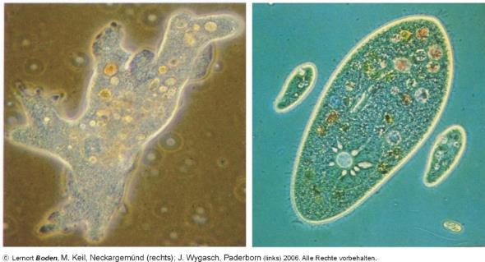
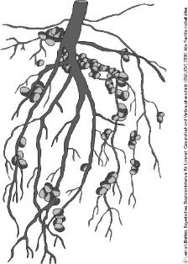
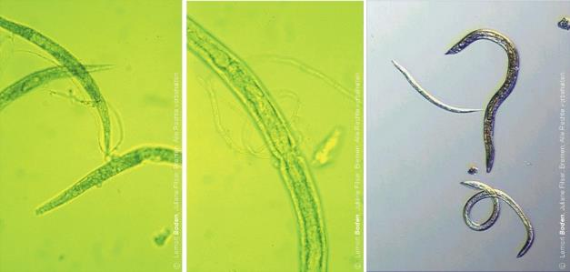
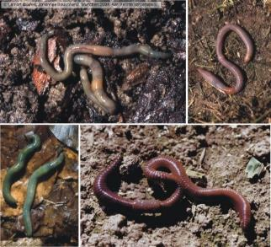
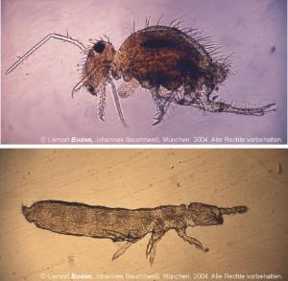
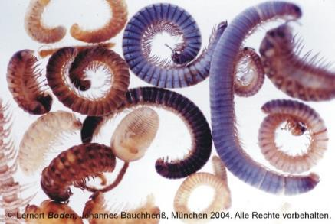
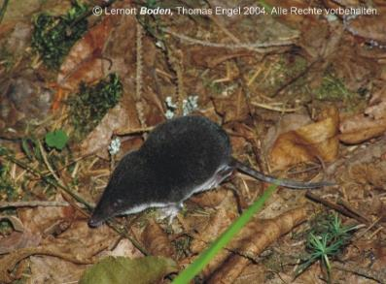
Soil biodiversity
The biodiversity in the soil is comparable to that in a rainforest or coral reef" (David Russell, Senckenberg)
Notes:
Soil biota includes archaea, bacteria, protists, tardigrades, rotifers, nematodes, acari (mites), collembolans (springtails), worms (enchytraeids and earthworms), macroarthropods (e.g. ants, termites, centipedes, millipedes, woodlice, etc.) and burrowing mammals. It also includes plant roots, fungi and lichens. Root exudates attract a variety of organisms that either feed directly on these secretions or graze on the microorganisms concentrated near the roots, giving this busy environment the name ‘rhizosphere’. There are also beetle larvae, flies and butterflies that use the soil as a temporary habitat to reproduce or to spend their early life stages feeding on different live and dead plant materials until they reach their maturity. All of these organisms are involved in creating and maintaining the soil structure and providing essential ecosystem services for humans (such as regulating greenhouse gas emissions or preserving water quality).

Slide 5
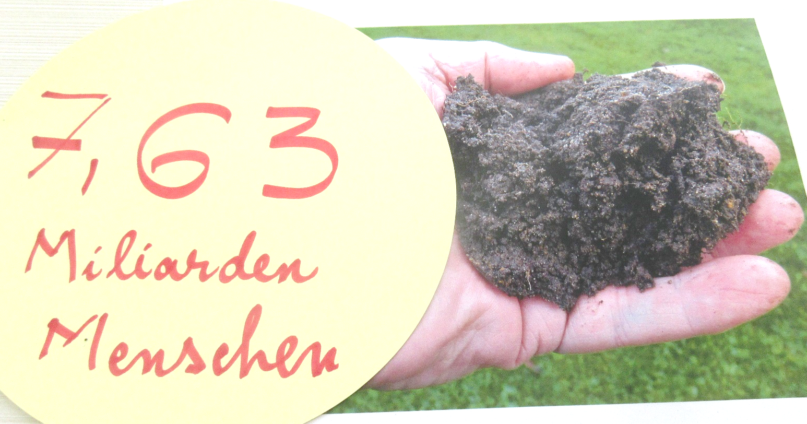
Importance of soil life
Decomposition of plant residues
Participation in the formation of humic substances
Stabilization of soil aggregates (mucilages)
Mineralization of organic substances and release of nutrients
Promotion of chemical weathering
Conversion of organic compounds
Binding and release of atmospheric nitrogen (e.g. Rhizobium bacteria)
Enlargement of the root system (e.g. mycorrhiza),
Oxidation and reduction of compounds of numerous elements
Notes:
One of the main challenges that soil conservation faces today is the lack of awareness of the ecological importance of soil biodiversity.: why All life and well-being, depends on it.
It´s the basis of fertility and foodgroth,
it´s part of the regulation of our planets climate as microbes are really key to the fight against climate chnge

Slide 6
Invertebrates
Invertebrates are a prerequisite for the functioning of ecosystems. Their role in humus formation, pollination of flowering plants, water retention, as regulators and as a food source for vertebrates is irreplaceable
Living soil contains an incredibly high number of invertebrates. The number of nematodes, annelids, springtails, mites and insect larvae alone amounts to several million per hectare.
The biomass of the respective species is an indication of their ecological importance and a measure of their participation in material cycles.
Notes:
Invertebrates fulfil central ecological functions as an essential part of the food web between plants and animals in the various ecosystems. Forests, water bodies, fields and grassland are inextricably linked to the presence of invertebrates. They are "eco-service providers" without whom the material and food cycles in our ecosystems would collapse. They ensure that the soil remains fertile and contribute to water purity.

Slide 7
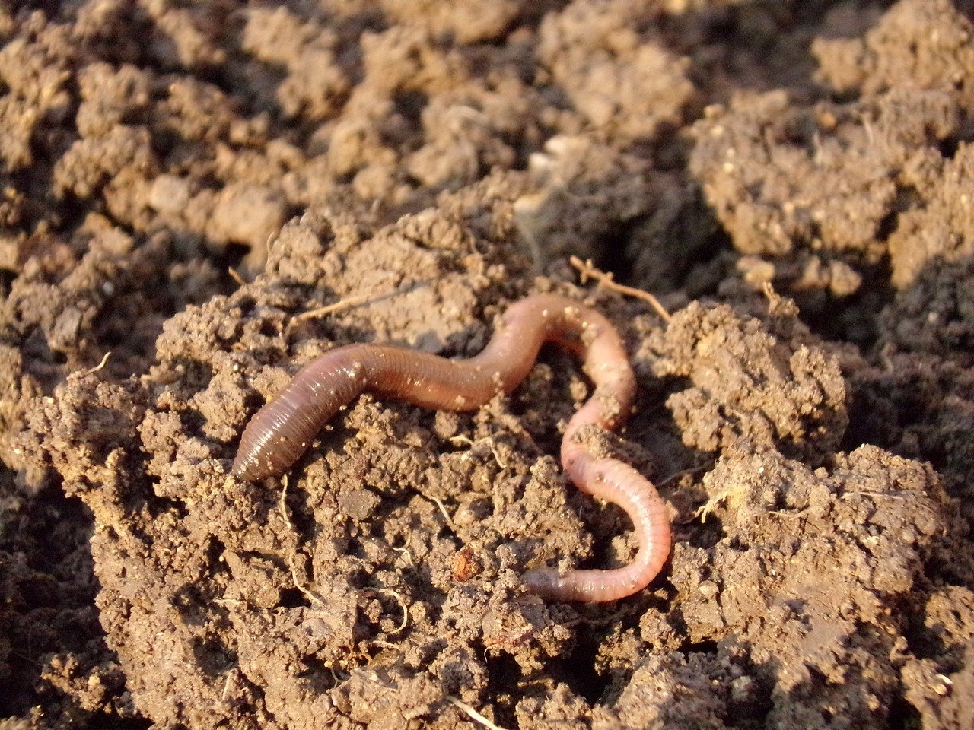
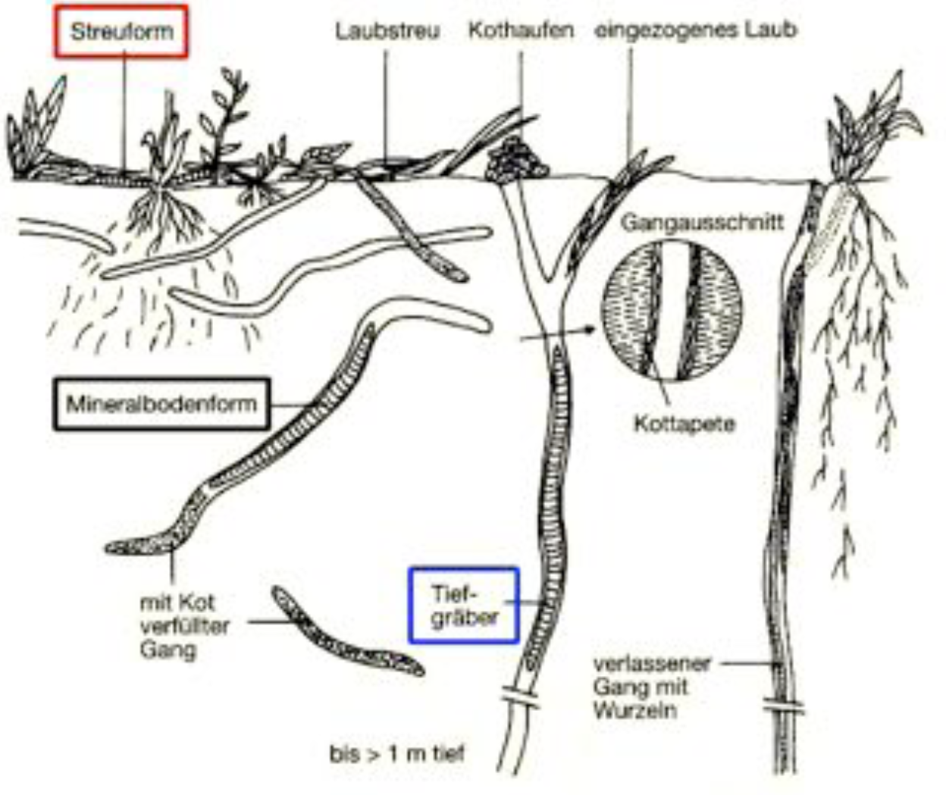
Earthworm (Lumbricidae)
For example, the species-poor animal group of earthworms with 40 or a maximum of 400 g per m² of soil surface (Brauns 1968) represents the majority of the biomass of the fauna in normal soils.
The highest density of earthworms can be found in grassland. Extrapolated to one hectare, the figures are impressive:
2.3 million earthworms with a biomass of 2.44 tons per hectare were counted
In this case, the number of individuals corresponds to the number of residents in the greater Munich area and the biomass corresponds to the weight of five livestock units (5 x 500 kg; Bauchhenss 1994).
Maximum values ​​were used for the longitudinal muscles with a pressure of 265 g / cm2
calculated for the ring muscles 1325 g / cm2.
For comparison: a person weighing 70 kg exerts a pressure on the floor of approximately 250 g / cm2.
Notes:
With their living tubes, they ensure drainage and aeration of the soil and create root channels for plants. Their activity involves what is known as bioturbation, the recycling of organic waste and even the killing of germs. Three life forms can be distinguished: Deep diggers like the earthworm are large and strong and can create almost vertical burrows up to a depth of two meters.
Litter forms are small and agile and live close to the soil surface in the organic material of the topsoil. They include the compost worm (genus Eisenia).
Mineral soil forms are sluggish and have a translucent pale color throughout their entire body, as they rarely come to the surface.

Slide 8
Decline in biodiversity of soillife
Citizen science project "#60minworm" found out that soils worm species declined dramatically
Deep burrowers were hardly present anymore
In addition, the decline in worms is linked to the drastic decline in the song thrush (Turdus philomelos)
The situation in Germany is not much better. According to the WWF analysis, more than half of the 46 earthworm species are classified as “very rare” or even “extremely rare”
In agricultural used sites also the number can fall to less than 30 animals per square meter. The average in small-scale fields is around 120 specimens, and in less ploughed fields in organic farming, over 450 worms can be counted.
Fig. Earthworm burrows absorb rainwater into deeper layers and improve the water storage capacity of the soil. At the same time, they facilitate the penetration of plant roots (colored white in the picture).
Notes:
(Deep burrowers provide ventilation and are important for the water balance (Fig.).

Slide 9
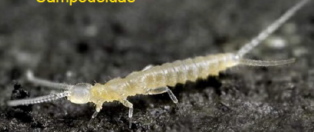
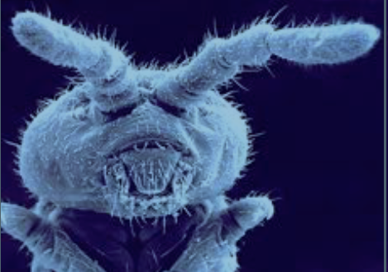
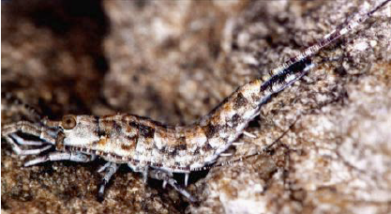
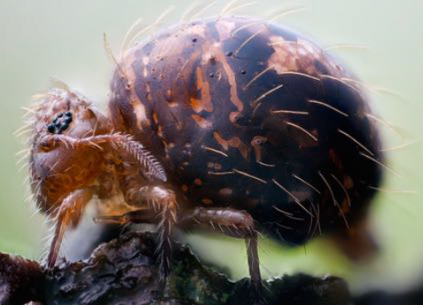
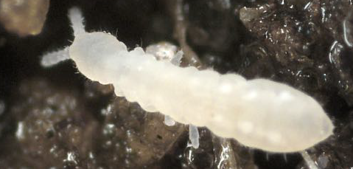
Crazy soil life – Collembolans
Doppelschwänze
Beintastler
Gletscherfloh
Felsenspringer
Rock skipper Machilis fuscistylis: an example of inner-alpine ice age survival
Kugelspringer
Bildnachweise nicht vorhanden
Notes:
Between 10,000 and over 100,000 individuals live in the top 30 centimetres of one square meter of forest soil in temperate latitudes. This makes them the second most numerous group of animals in the soil after mites. Several species are known to be able to absorb and immobilize heavy metals from the soil. These abilities, among others, make collembolans important initial colonizers and recolonizers of disturbed or contaminated soils, such as flooded floodplain soils[19] or spoil heaps[20].

Slide 10
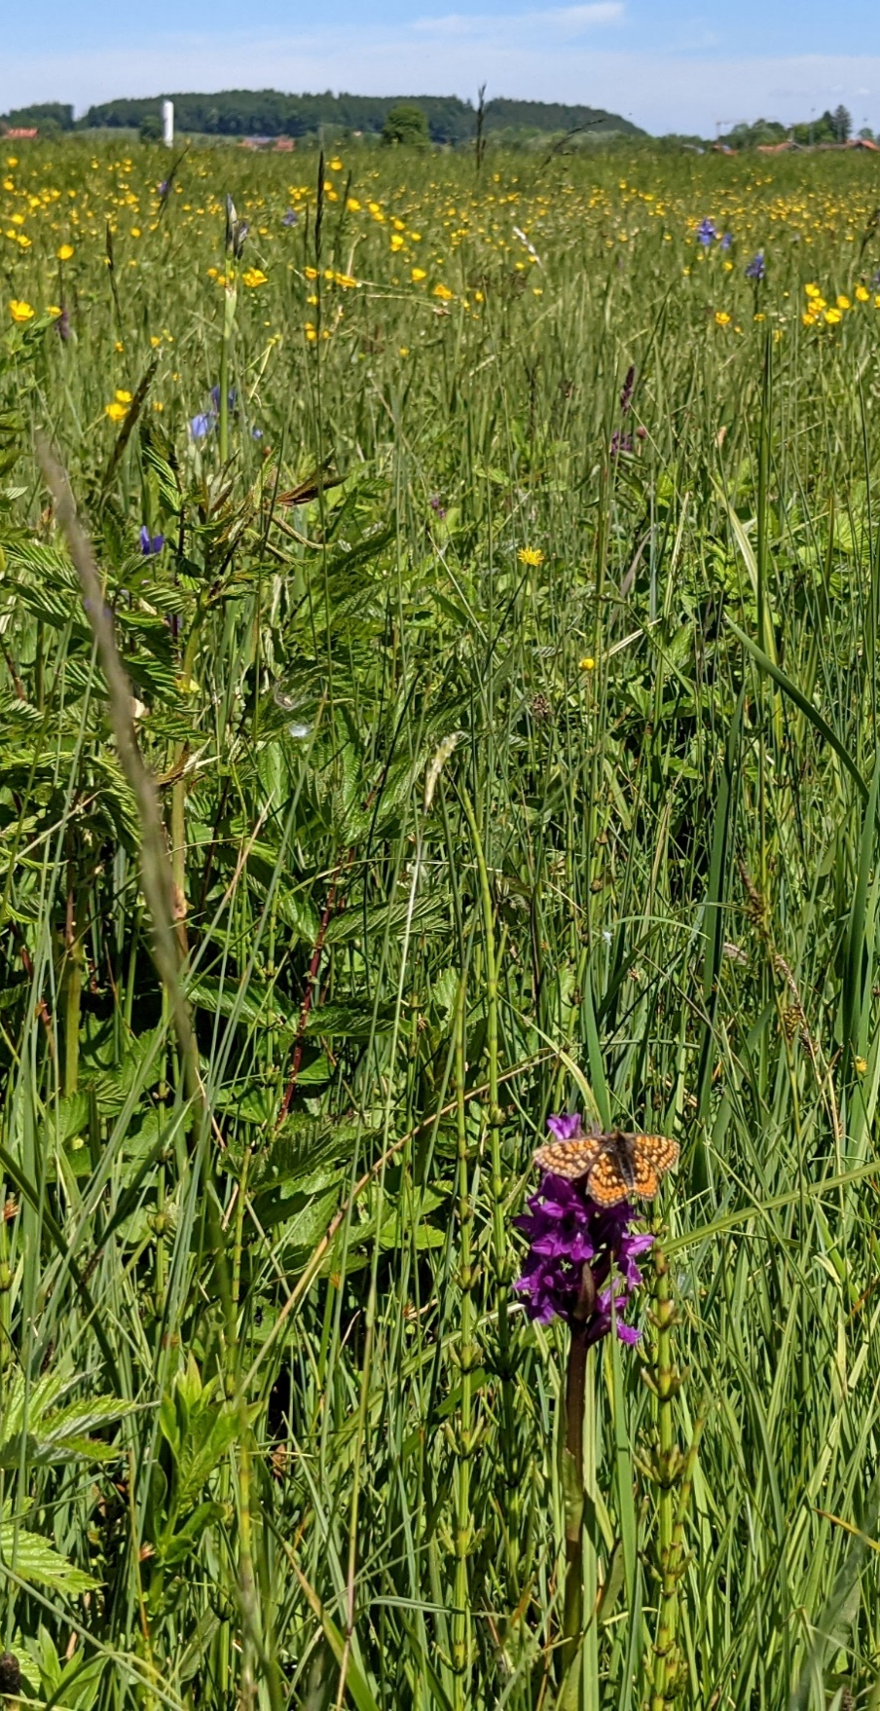
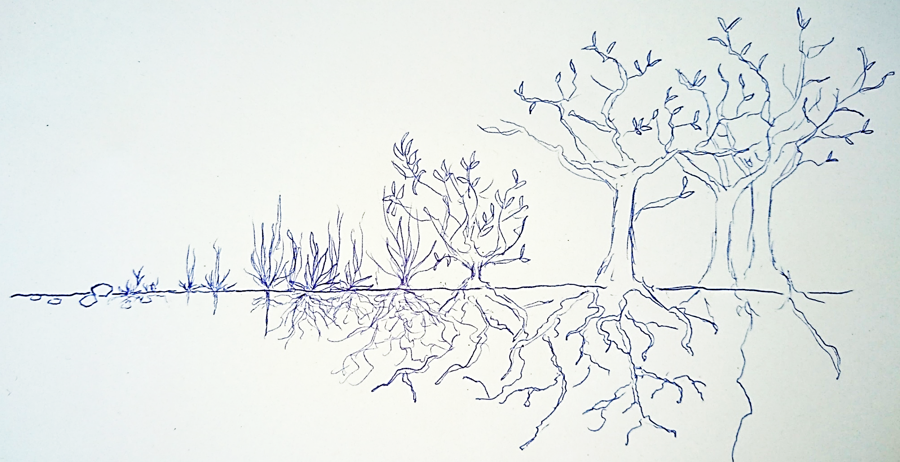
Don´t forget the fungi
more bacteria f:b = 1:100 1:10 1:3 1:1 2:1 5:1 100:1 1000:1
bacteria ➔ few fungi ➔ equilibrium ➔ more fungi ➔
Pic: Dactylorhiza majalis (Susanne Reichhart)
Notes:
They bring us cheese, wine and beer but not only that they are ancient species that covered the earth before plants came out of the water.
The interaction between plants and funghi is therefore as old as plants itself.
Grow into huge networks, a fungus in US is documented to grow since 1500 years and now weighs 10 tons and covers thousands of square meters. The older the soil, the more mycorrhiza,

Slide 11
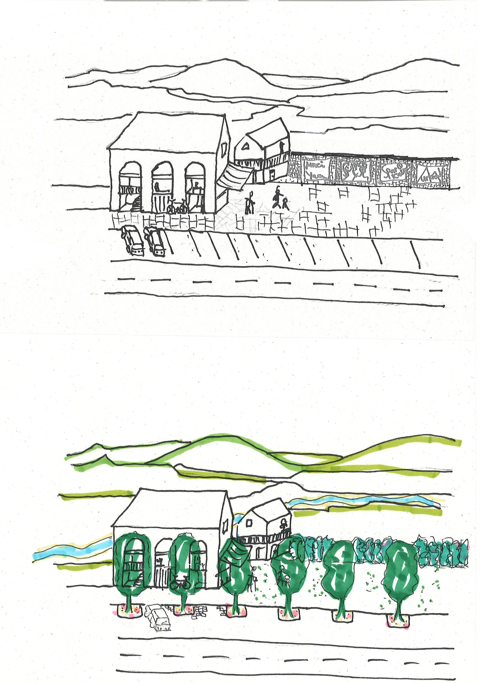
Soil life protection by unsealing
Sealed surfaces
Pavement with asphalt
Concrete walls
Concrete tiles
Vertical and horizontal barriers
Fig. Town square with sealed surfaces (Susanne Reichhart)
Notes:
Soil life protection by unsealing! Many sites in urban areas have been sealed for practical reasons. It's cheap, requires little manual labour, so it's quick and easy to establish an asphalt layer - not much knowledge is required. The snowplough and other machines can easily maintain an asphalt site, it's easy to keep it clean and tidy without organic matter lying around. But it's also a dead place, and in the meantime climate change is forcing us to have a different view of tidy places. Protecting soil life benefits from the urge to eliminate heat islands. What does 40 degrees mean - calme down quickly (fever) at 42 degrees more serious -protein dehydrated – its no longer reversible (boiled egg no longer becomes soft)!

Slide 12
Unsealing and soil life – think of corridors
Find a biodiversity enhancing concept for your village or city
Wildlife habitats
Restoration of rivers and creeks
Creating species-rich meadows
Regional and indigenous plants, shrubs and trees
Fresh air corridor
Vertical and horizontal permeability
Create opportunities for soil life migration
Network of biotopes
Stepping stone habitates
Fig. Town square with unsealed surfaces (Susanne Reichhart)
Notes:
Where do the animals come from, is there a connection between the unsealed soil and natural soil? Do we have to jump start by topsoil transfer. Lots of collembolas are transported per wind, so we have to think of fresh air corridors where winds transfer soil life!

Slide 13
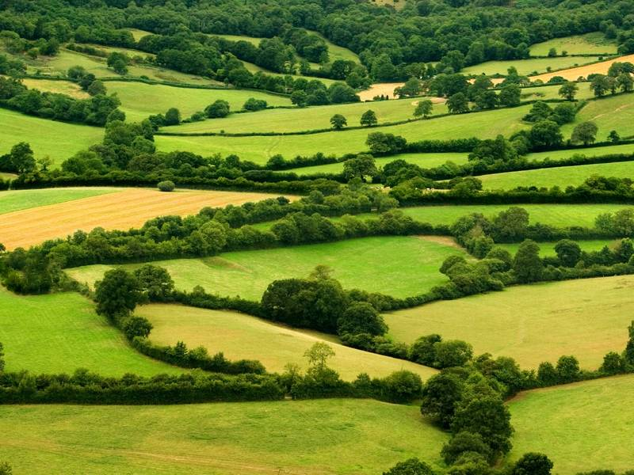
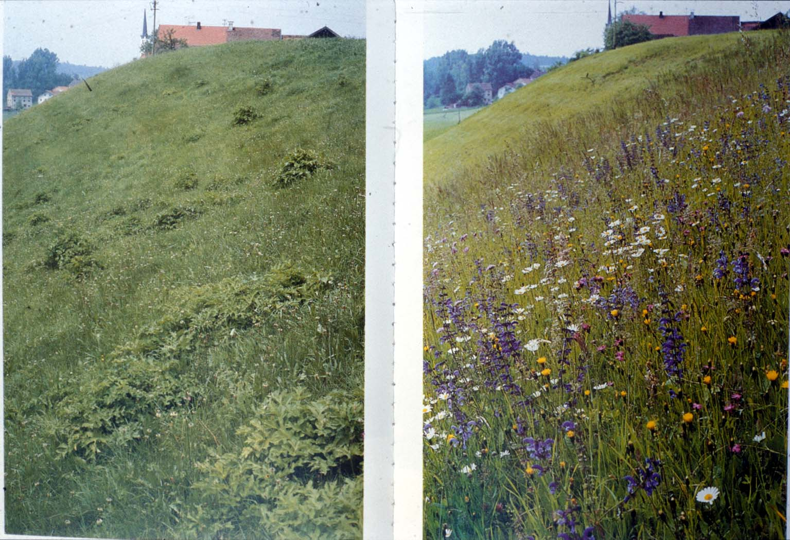
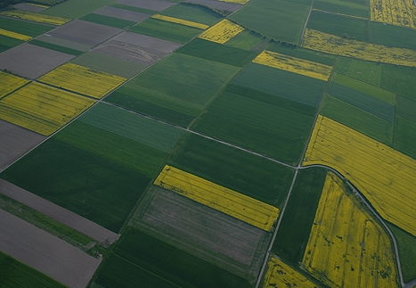
Think on landscape scale
Notes:
Our landscape was structured by hedges, trees, streams and watercourses before the land was consolidated. Agricultural plots became larger and larger and landscape features such as old trees, natural fences and hedges were removed. In order to be able to use their tractors, farmers started to restore grassland and fields. Machine utilisation is limited on uneven surfaces. By ploughing up and levelling the area and reseeding, ideal conditions were created for tractor cultivation. On the other hand intensification of agriculture, conversion from 3-cut meadows to 7-cut meadows, multiple fertilisation have led to the loss of species-rich meadows. We need to reverse the negative trend of the last 60 years by trying to integrate biodiversity inhancing elements into not only agricultural practices but also into our cities and villages by thinking in greater scales. For ex. Establishing nature walks… and little biotopes.

Slide 14
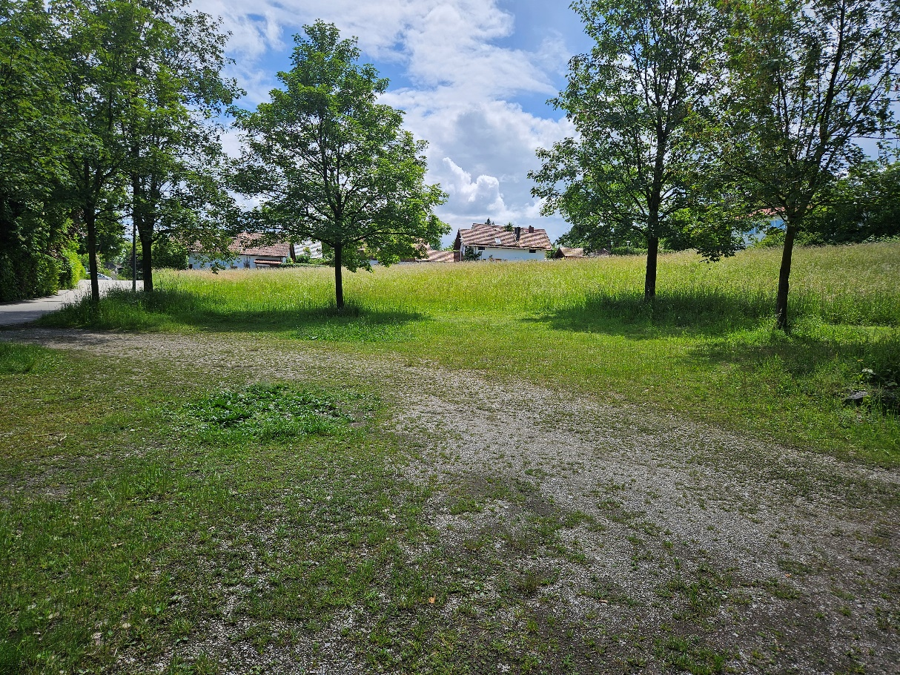
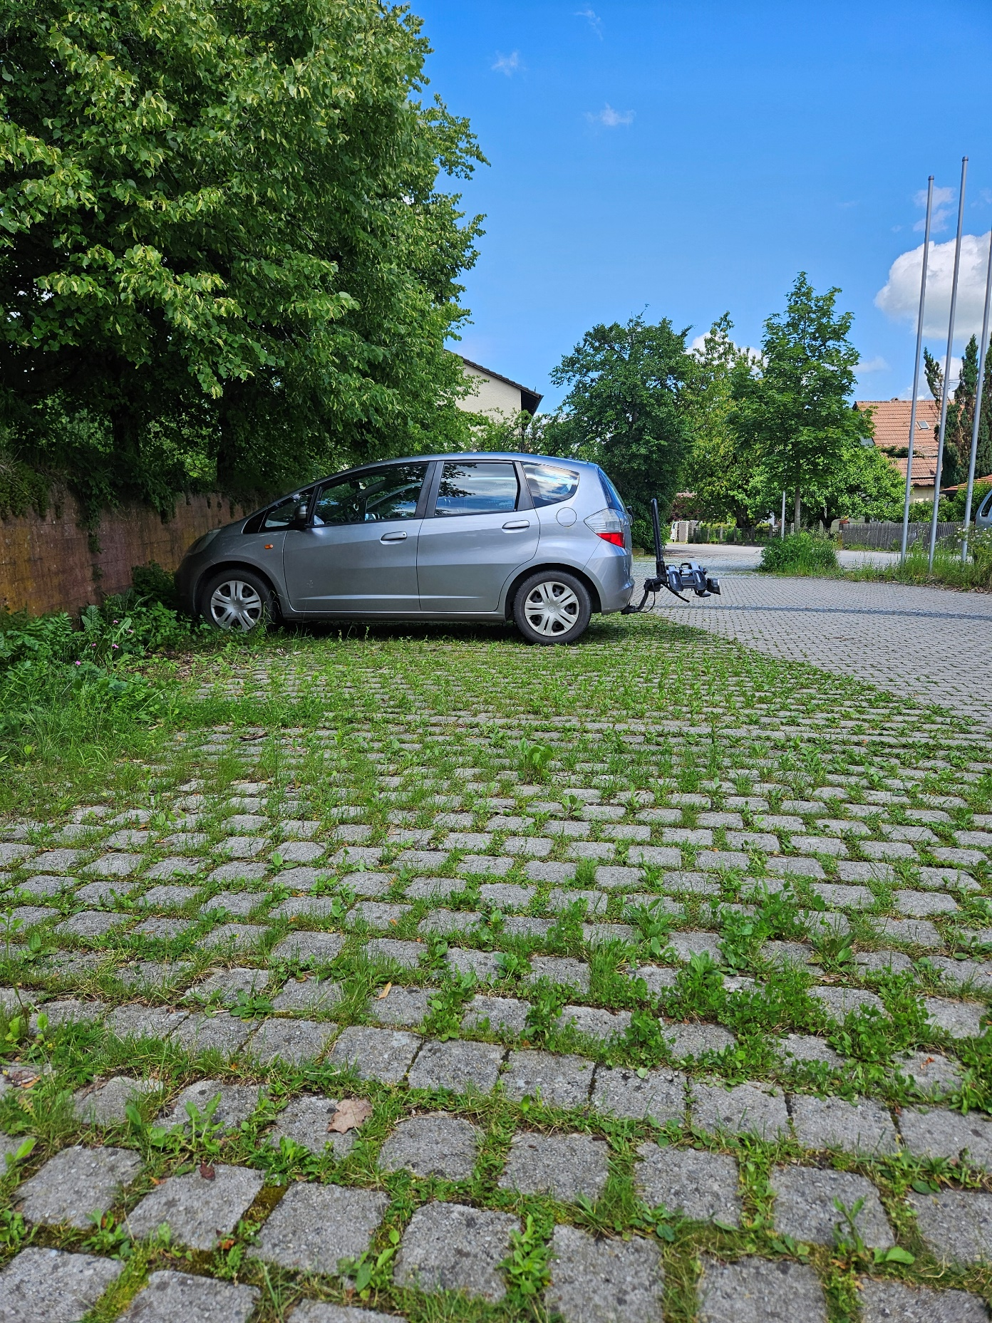
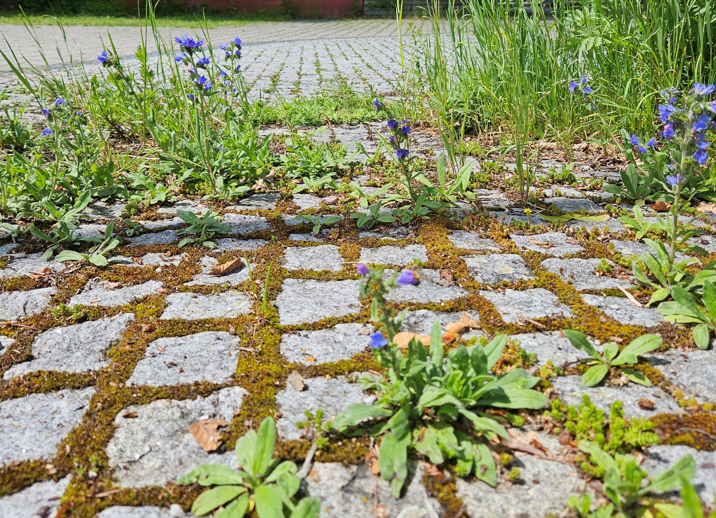
Ideas for the new tidy
Notes:
It´s important that plants are able to grow through the paving – ist not unsealed parking lots like a water bound surface layer in the second picture . There is permeability given vertical and horizontal where f.e. earthworms can migrate from the meadow into the parking area.
You can see some fotos of the new tidy. We really have to work ona new perspective of peoples ideas of what is nice and tidy and why it is ok to be lazy and not so tidy. nature isn´t neatly arranged, it´s not cleaned up neatly. Soil life requires organic matter
As the global hydrological cycle intensifies with global warming, deeper droughts and rewetting will alter, and possibly transform, ecosystems. Soil communities, however, seem more tolerant than plants or animals are to water stress—the main effects, in fact, on soil processes appear to be limited diffusion and the limited supply of resources to soil organisms. Lots of soil species need plants as a source, so why don´t we accept plants growing throw our paving?

Slide 15
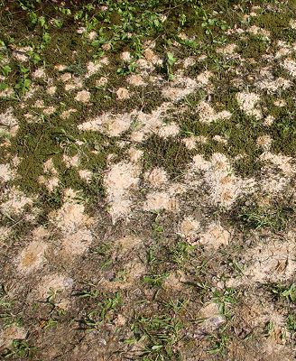
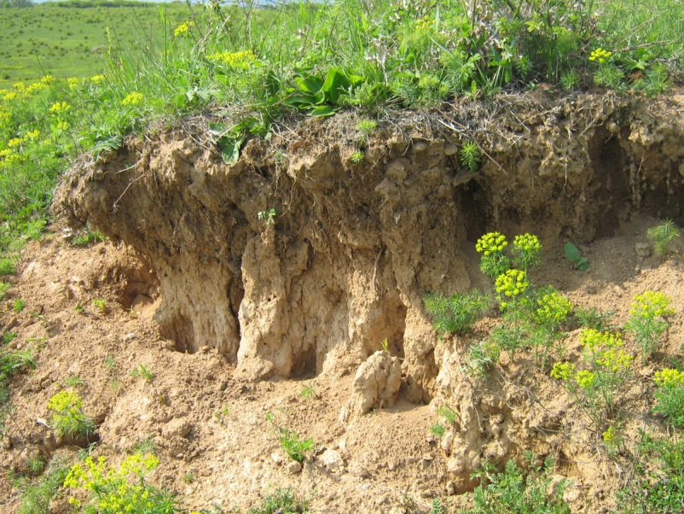
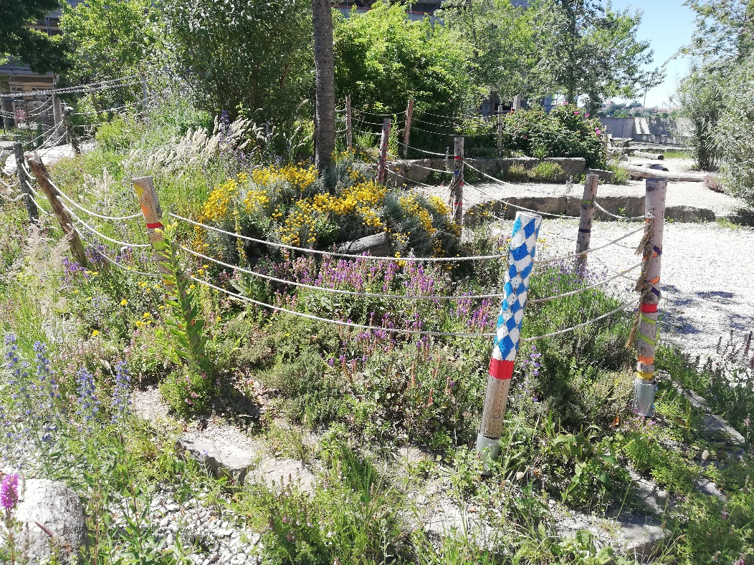
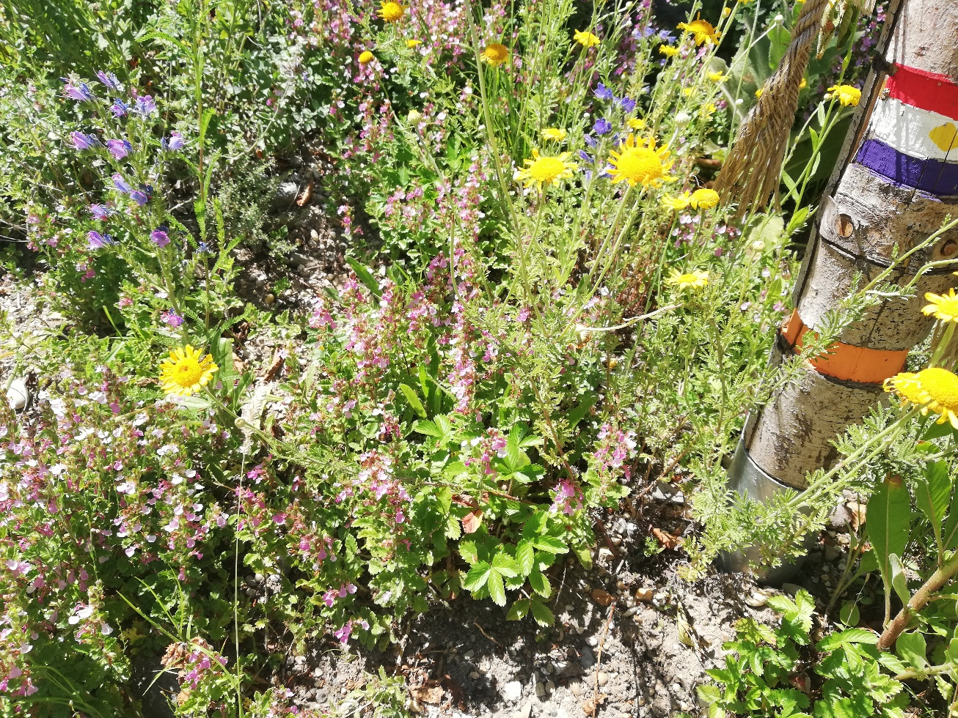
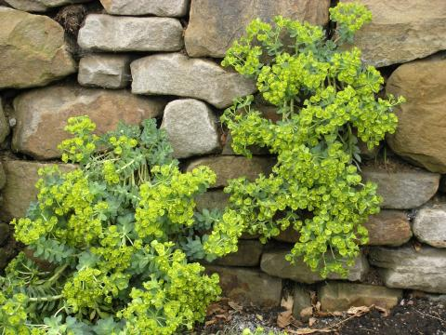
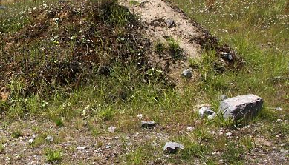
Encorage soil life by enhancing biodiversity above ground
Notes:
Encourage soil life by using plants that attract wild bees and butterflies. Wildbees and also a lot butterflies, grashoppers, beetles, ants use soils for nesting: the substrate therefor should be loose, lean, sparsely vegetated, sandy, often slightly sloping. So unpaved paths, ruderal areas, hills, embankments, gravel/sand pits, floodplains, rough grassland are possible habitats for especially wildbees.

Slide 16
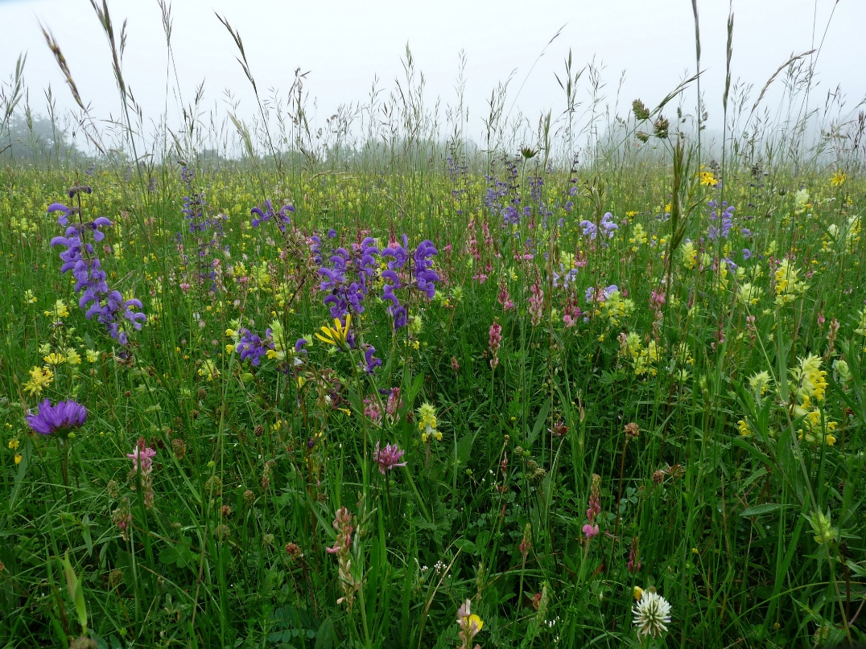
Unseal and form species-rich plant communities that attract pollinators
The most colorful flower meadows can be found on less nutrient-rich soils, on lean soils in full sun.
The best way to create species-rich meadows is to use local seeds and mowed material:
  This preserves the special local genetic characteristics
  Optimally preserves the relationships between insects and plants
Species rich meadows from nearby sites provide the seeds for the unsealed area
Two methods:
  brushing out process
  Meadow threshing method

Slide 17
How to stimulate soil life?
Plant diversity
Dead plant material
No ploughing, no tillage
Little organic fertilisation with straw content (solid dung)
Aerobic conditions
Promotion of fungi (moulds, ray fungi, yeasts) by dead wood and leaves
    Ammonia is bound and slowly released for plant use
    Pathogens are rendered harmless
    Vitamin producers
The more diverse the soil life, the healthier the soil and it´s plants.

Slide 18
Susanne Reichhart
Susanne.reichhart@anl.bayern.de
50

